Slide 1
Sustainable Urban Development
Mahmoud Nasser Gouda

Slide 2


Slide 3
Sustainable Development
Is the development that meets the needs of the present without compromising the ability of future generations to meet their own needs.

Slide 4
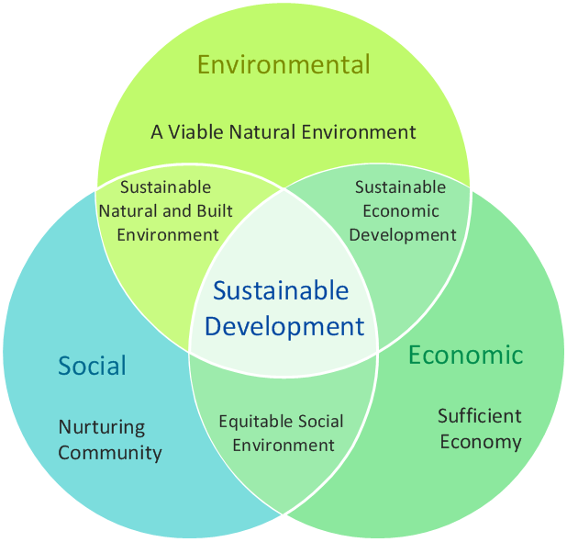

Slide 5
Sustainable urban development
Is the study of developing cities, while promoting their long-term viability by reducing consumption, waste and harmful impacts while enhancing the overall well being of both people and place.

Slide 6
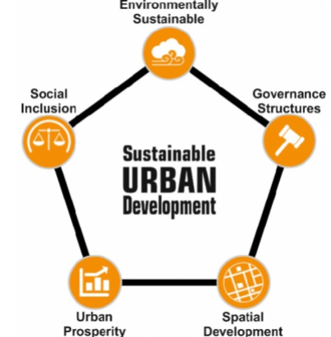

Slide 7
Sustainable urban development
seeks to create cities and towns that improve the long-term health of the planet’s human and ecological systems.

Slide 8
Sustainable urban development
Is the urban development processes that creates a built environment while enabling individuals and societies to maximize their potential, so that neighborhoods and cities are planned, built and renewed restraining adverse impacts on the environment while maintaining the quality of life, needs and livelihood of its present and future populations.

Slide 9
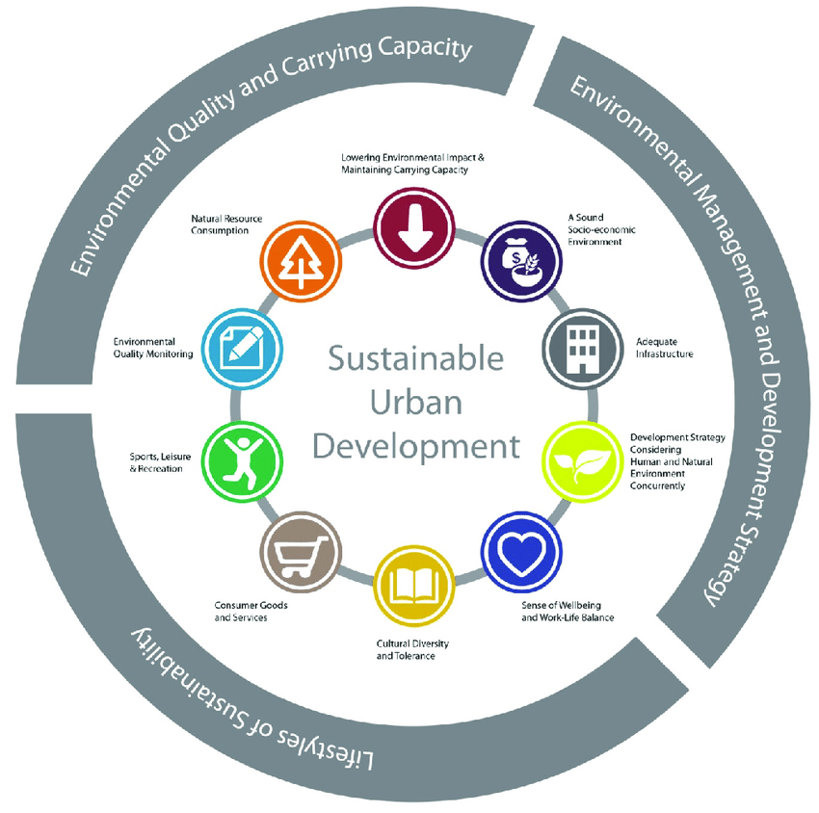

Slide 10
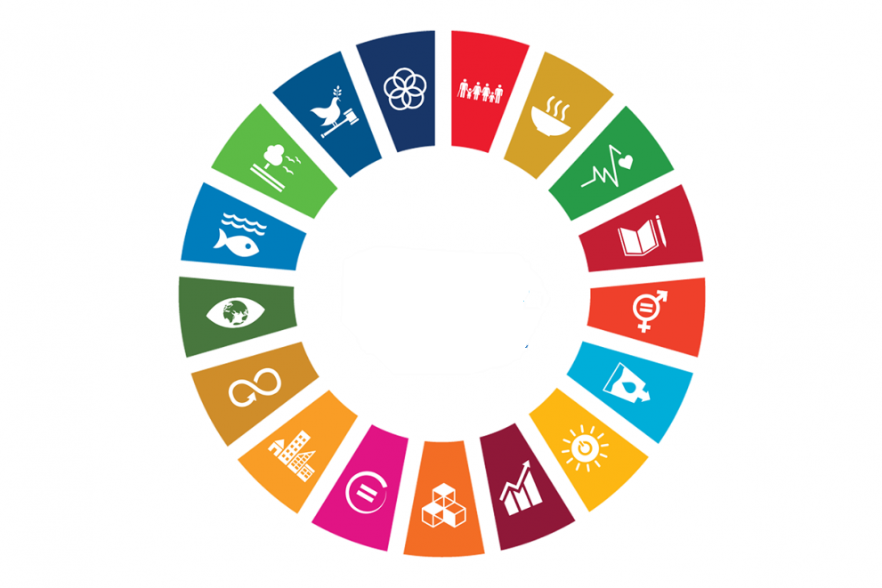


Slide 11
The 2030 Agenda for Sustainable Development, adopted by all United Nations Member States in 2015, provides a shared blueprint for peace and prosperity for people and the planet, now and into the future. At its heart are the 17 Sustainable Development Goals (SDGs), which are an urgent call for action by all countries - developed and developing - in a global partnership.

Slide 12

Do you know all 17 SDGs

Slide 13
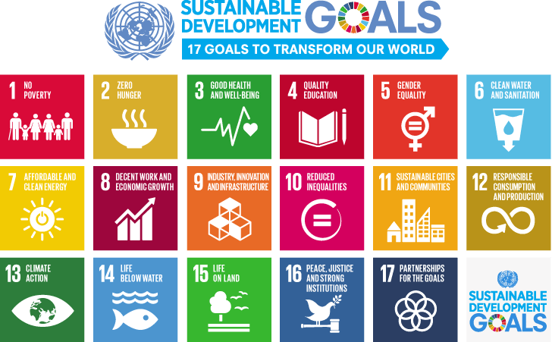

Slide 14

The Sustainable Development Goals Report 2022

Slide 15
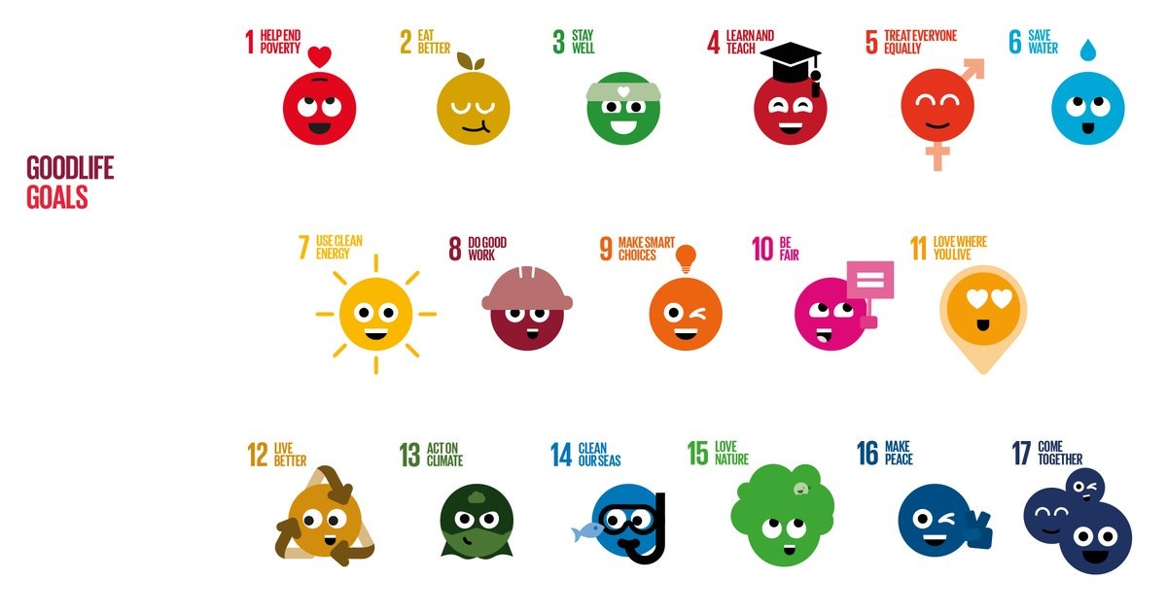

Slide 16
Questions?

